Slide 1
Fibonacci Retracement and Extension Levels
By @CryptoCred

Slide 2
Disclaimer
Neither this presentation, nor anything on my Twitter, Telegram, or any other medium/mode of communication, including private correspondence, constitute financial advice. I am not a financial advisor and hold no formal qualifications in this area. Trade entirely at your own risk. This is for entertainment purposes only.

Slide 3
Shoutout
@I_Am_ICT
@CryptoRedPill
@Trader_Dante
@Tradermayne

Slide 4
Outline
General Remarks
Setting Up the Fibonacci Retracement Tool [TradingView/Coinigy]
Fibonacci Anchor Selection - Which Highs/Lows to Pick
Using Fibonacci Levels to Identify Support/Entries
Using Fibonacci Levels to Identify Resistance/Targets
Using Fibonacci Levels to Identify Resistance/Targets at ATH
Advanced Concepts
How I Use Fibonacci Levels
Conclusion

Slide 5
General Remarks
The focus of this lesson - the Fibonacci retracement tool - can be used to draw retracement as well as extension levels
Ask 5 traders how they use Fibonacci levels and you’ll likely get 5 different answers - I am covering the basics/(hopefully) least contentious variations
Understanding what swing highs and swing lows look like is very helpful
0.5/50% isn’t a Fibonacci number but it’s an important retracement level nonetheless
Fibonacci levels are great for adding confluence to your setups, regardless of whether you use price action, indicators, patterns, harmonics, etc.
There’s lots of wiggle room when it comes to setting up Fibonacci levels - experiment & see what works for you
I don’t use Fibonacci levels to project support/entries at ATL

Slide 6
Setting Up the Fibonacci Retracement Tool
Outlined in video.

Slide 7
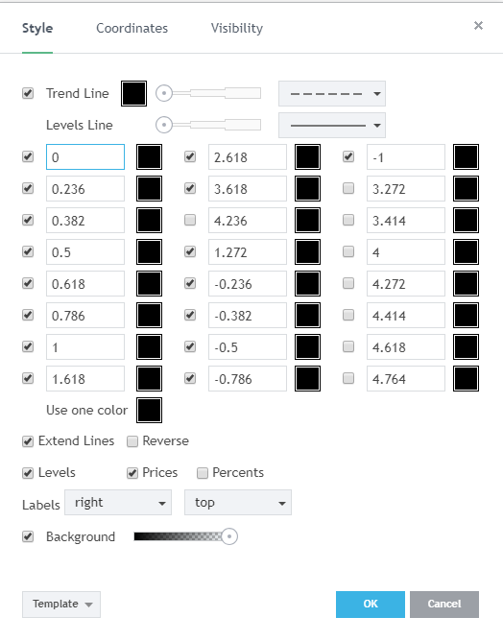

Slide 8
Fibonacci Anchor Selection - Which Highs/Lows to Pick
Understanding what swing highs and swing lows look like is helpful for effective Fibonacci anchor selection
Swing high - a high + lower high on both sides
Swing low - a low + higher low on both sides
Wicks or candle bodies?
Use the wicks to identify the swing high/swing low
You can however use the candle bodies to anchor your Fibs i.e. highest close/lowest close as opposed to the absolute high/low

Slide 9
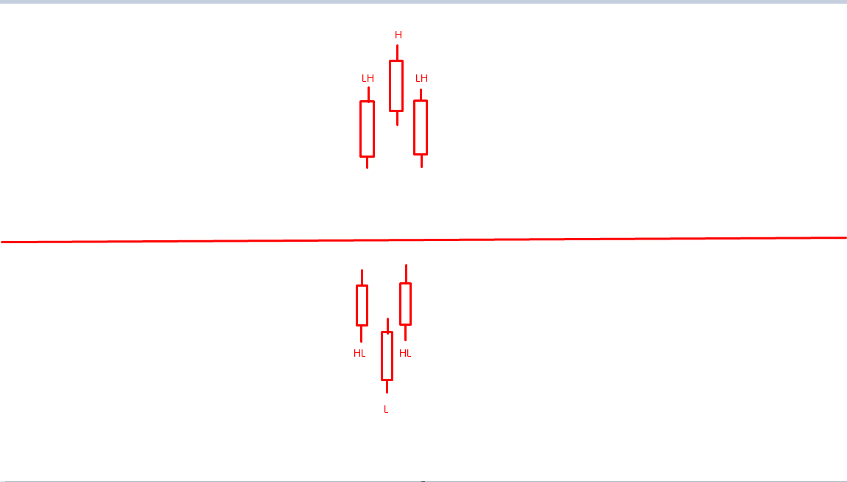
Fibonacci Anchor Selection - Which Highs/Lows to Pick II
Swing High
Swing Low

Slide 10
Fibonacci Anchor Selection - Which Highs/Lows to Pick II
So you know what a swing high/swing low looks like - but there are loads of them!
How does one identify which specific swing high/low is a good place for an anchor?
No ‘objective’ answer - hence why so many traders set up & use Fibs differently
My preference - deep/obvious/stand out swings → ones which your eye is drawn to
Remember institutional order flow lesson: which swing high/low will entice traders?
Summary:
Swing highs and swing lows - which usually form at the top/bottom of a move - make for good anchors
When refining which swing high/swing low to choose - the good ones tend to be the obvious ones
These criteria are valid across all time frames i.e. you can apply these regardless of whether you’re ‘Fibbing’ big 1D moves or smaller time frame scalps

Slide 11
Using Fibonacci Levels to Identify Support/Entries
Basic premise: using Fibonacci levels to identify where price may retrace to after moving up
How:
Identify the base of the rally - a swing low
Identify the peak of the rally - a swing high/self-evident ‘top’
Select your Fibonacci retracement tool
Click 1: swing low
Click 2: swing high
Fibonacci levels will appear
Chart examples

Slide 12
Using Fibonacci Levels to Identify Resistance/Targets
Basic premise: using Fibonacci levels to identify where price may find resistance after a move down
How:
Identify the peak of the rally - a swing high
Identify the bottom of the move down - a swing low
Select your Fibonacci retracement tool
Click 1: swing high
Click 2: swing low
Fibonacci levels will appear
Chart examples

Slide 13
Using Fibonacci Levels to Identify Resistance/Targets at ATH
Basic premise: using Fibonacci levels to identify plausible targets/resistance when price is at ATH
How:
Identify a significant swing high AND/OR ATH
Identify a significant swing low AND/OR ATL
Click 1: the high
Click 2: the low
Fibonacci levels, including extension (1.XXX/2.XXX et cetera) levels, will appear
Chart examples

Slide 14
Advanced Concepts
Thus far we have learned how to identify potential support/resistance using Fibonacci levels - but one can also use the same Fibonacci setup to set targets if price finds support/resistance at a Fibonacci level
I learned this concept from @I_Am_ICT free videos → only this concept, overall he uses Fibs in a unique way and I recommend checking out his video (link in description) and mentorship for further details
How:
Refer back to setup slide and ensure that you’ve customised your parameters to include the negative Fib values
Set up as normal (ascertain whether you’re looking to buy a dip/sell a rally and Fib accordingly)
Targets: Negative Fib levels (but including 0 in case price fails to make a new high/low) using the same Fibonacci setup
Excellent for shorter-term plays/scalping setups
Chart examples

Slide 15
How I Use Fibonacci Levels
As always, DYOR and see what works for you → this is simply a tool, make it fit your preferences
My preferred uses:
Mapping 1D Fibonacci levels based on big moves/deep swings
Confluence only → I never trade a Fibonacci level on its own
I pay the most attention to .382/.5/.618 Fibonacci levels
To reiterate: this works best for me based on my higher time frame trading preference and style

Slide 16
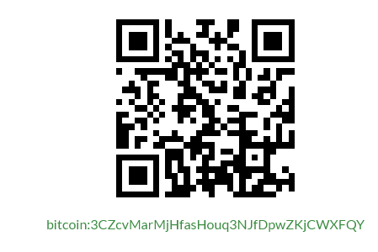
Conclusion
Thanks for watching - hopefully you learned something new!
As with all my other lessons, but especially this one, tailor the tool to your needs and preferences
---
I’m building one of the most comprehensive free trading resources - consider a $BTC donation
$BTC: 3CZcvMarMjHfasHouq3NJfDpwZKjCWXFQY
Good luck & happy trading!

